Slide 1
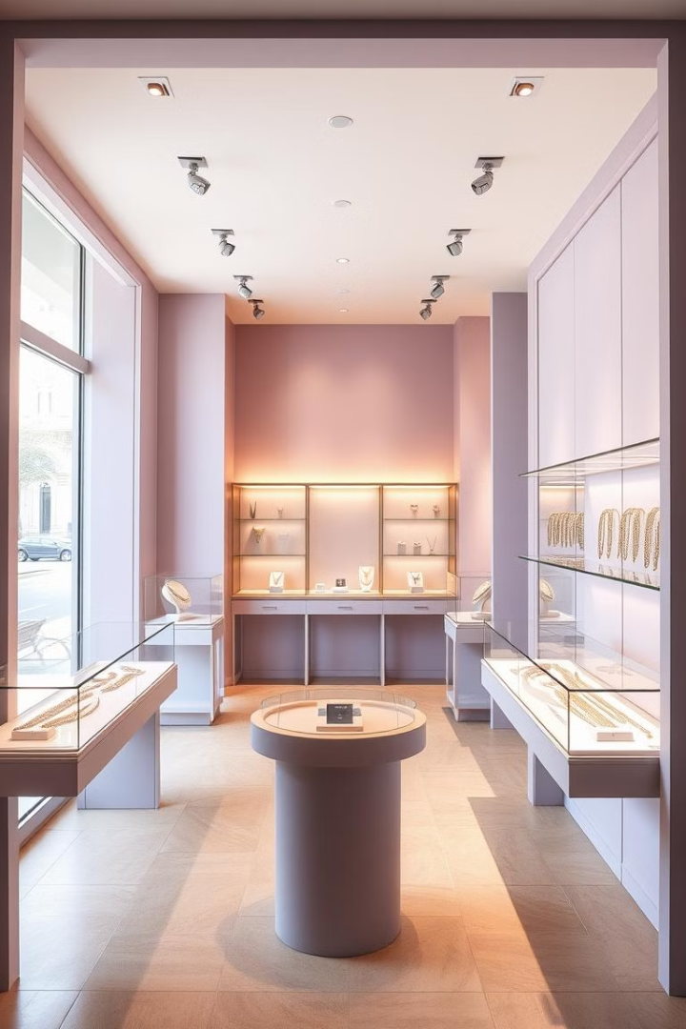
Online Jewelry Shop using HTML & CSS
This presentation outlines the steps for building a functional and visually appealing online jewelry shop using HTML and CSS.
Name - Aditya Raj
CRN - 2203393 , URN - 2215006

Slide 2
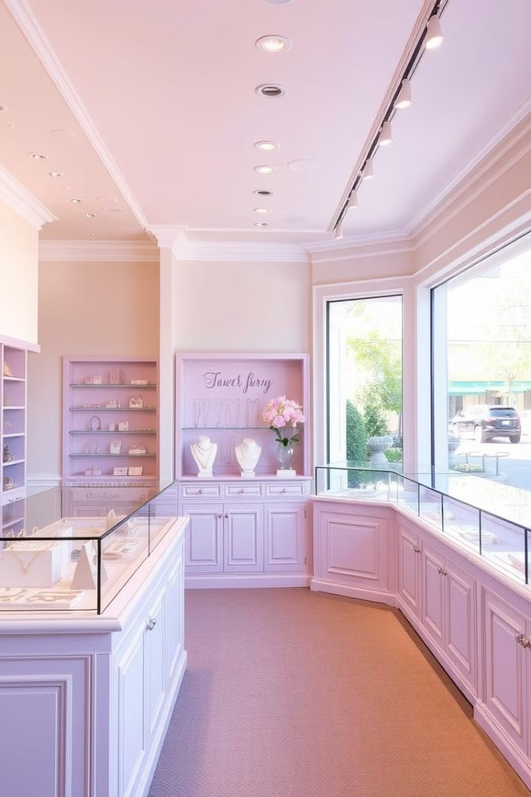
Intro to the Project
1
Purpose
2
Target Audience
The aim of this project is to create an online store selling jewelry items.
The target audience for this store is individuals who want to purchase jewelry online.
3
Features
4
Technology
The shop will include a product catalog, shopping cart, and secure checkout functionality.
We will use HTML for structure and CSS for styling and visual design.

Slide 3
HTML Basics for Jewelry Website
Structure
Content
Semantic Markup
We'll use HTML elements like <header>, <nav>, <main>, and <footer> to create a well-organized website structure.
We'll create elements to showcase jewelry items using <img>, <p>, and <div> tags.
Employing semantic HTML tags will improve accessibility and searchability of our website.

Slide 4
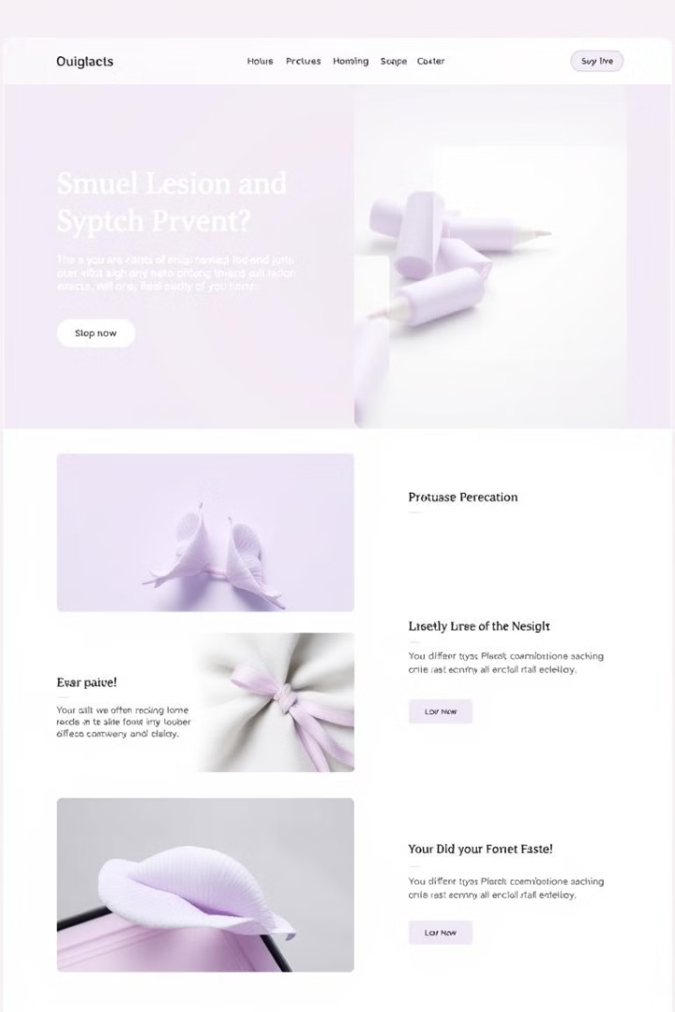
Structuring the Website Layout
Header
Navigation
This section will typically contain the logo, navigation menu, and possibly a search bar.
The navigation menu will provide links to different categories of jewelry and pages like About Us and Contact.
Main Content
Footer
This section will contain the product listings, individual product details, or other dynamic content.
The footer will contain copyright information, links to privacy policies, and possibly social media links.

Slide 5
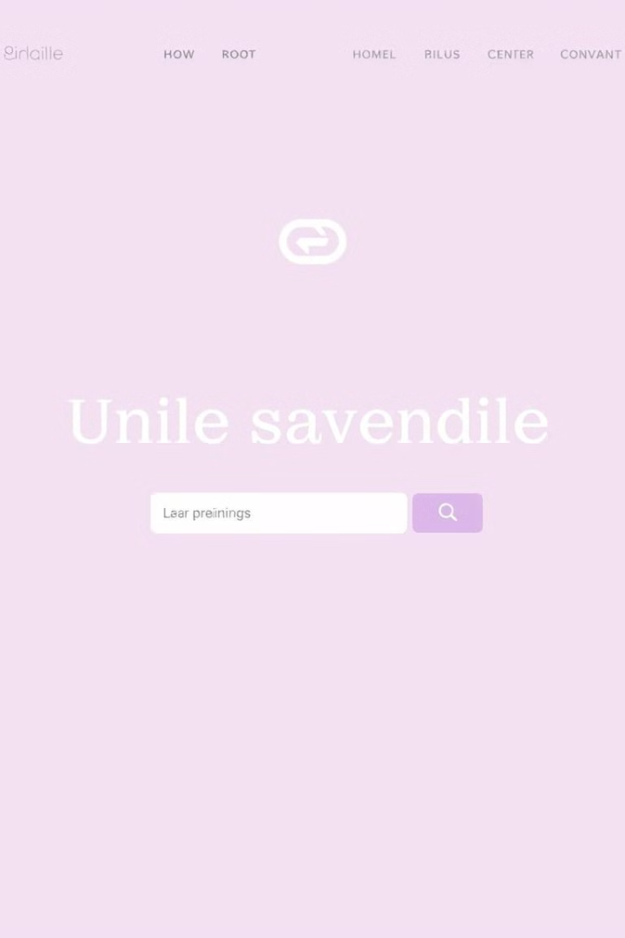
Styling with CSS: Colors, Fonts, and Branding
1
Color Scheme
Choose a color palette that reflects the brand identity and target audience.
2
Typography
Select fonts that are easy to read and enhance the visual appeal of the site.
3
Branding Elements
Incorporate the logo and any other visual elements that represent the brand.

Slide 6
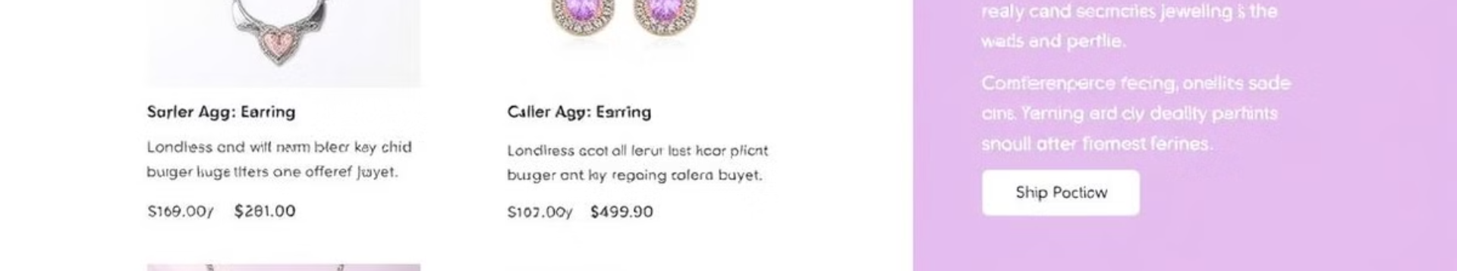



Creating Product Listings and Details Pages
Product Listings
Product Details
User Interface
Create a visually appealing grid or list of jewelry products with images, names, and prices.
Design detailed pages for each jewelry item with high-resolution images, descriptions, and purchase options.
Implement a user-friendly interface for browsing and selecting jewelry items.

Slide 7
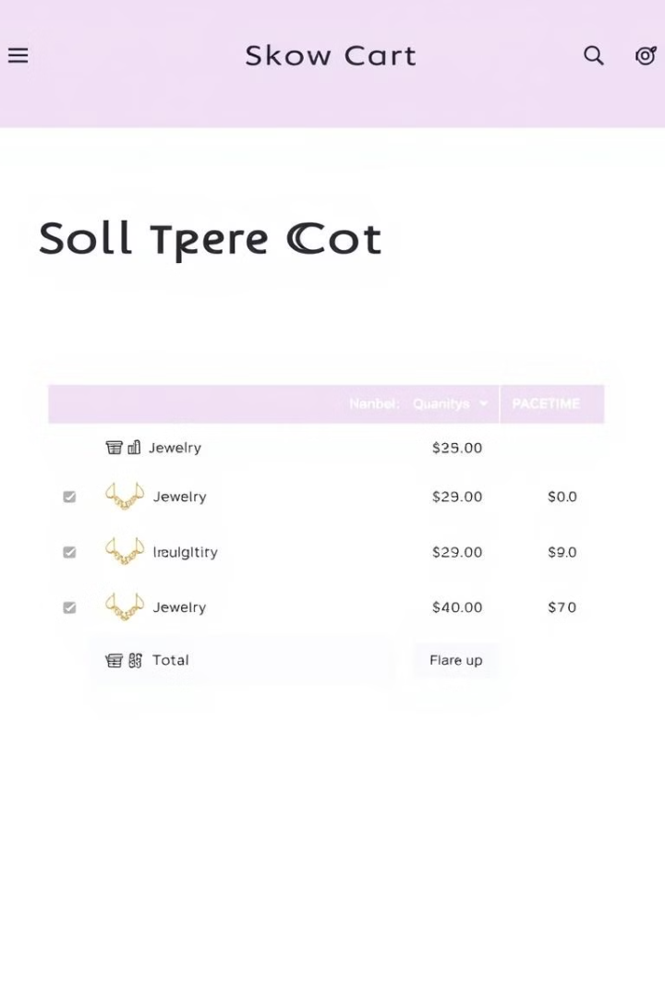
Implementing Shopping Cart and Checkout
Shopping Cart
Allows users to collect items for purchase.
Checkout Process
Provides a secure and user-friendly way to complete a purchase.
Payment Integration
Connects the site to payment gateways for processing transactions.

Slide 8
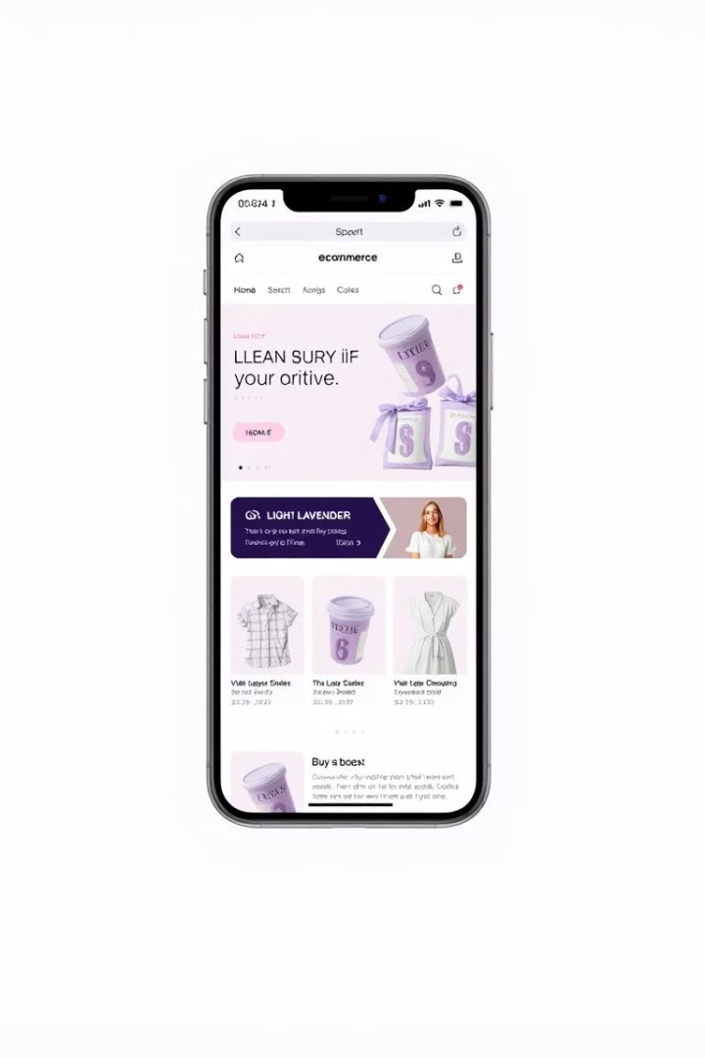



Responsive Design for Mobile Optimization
Viewport Meta Tag
Set the viewport meta tag to ensure the website adapts to different screen sizes.
Flexible Layouts
Use flexible layout techniques like percentages and relative units for responsive sizing.
Image Optimization
Optimize images for different screen sizes to reduce loading times and enhance performance.

Slide 9
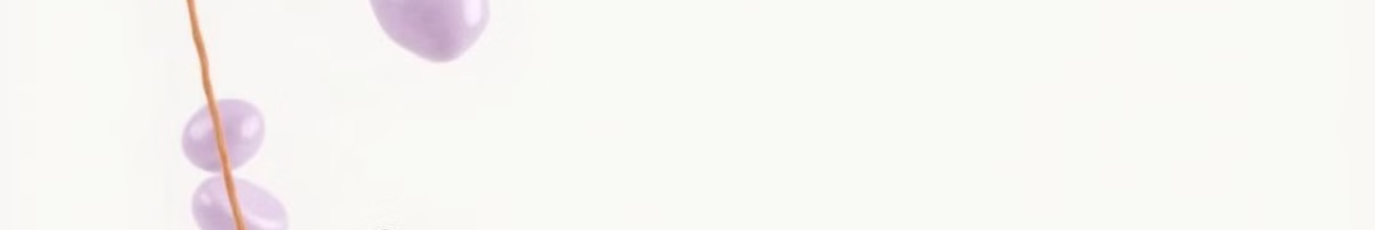
Site Navigation and User Experience
1
Navigation Menu
Create a clear and intuitive navigation menu that allows users to easily browse different categories.
2
Search Functionality
Implement a search bar that enables users to quickly find specific jewelry items.
3
User-Friendly Design
Prioritize user experience by making the site easy to navigate and visually appealing.

Slide 10
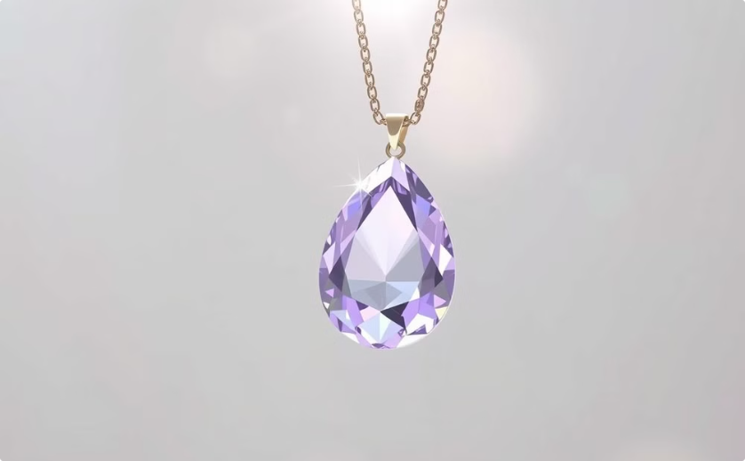
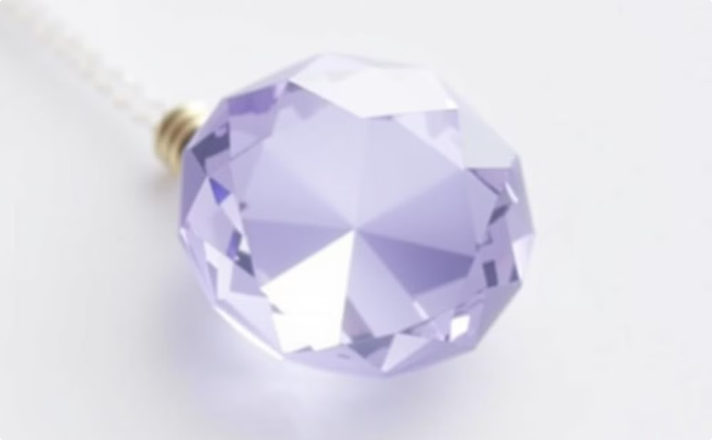
Advanced CSS Techniques (Animations, Transitions)
Animations
Transitions
Add engaging animations to make the website more interactive and dynamic.
Use CSS transitions to create smooth visual effects for hover states and other user interactions.

